Slide 1
PART III. Considerations for large-scale and network data
Notes:
In this part, we focus on basic methods for causal inference, with integrated learning about assumptions and validation tests. Methods will be demonstrated using a Jupyter python notebook and examples of causal problems in online social data.

Slide 2
PART III. Special considerations with large-scale and network data
High-dimensional data
Network Effects
Data about People
Notes:
In this part, we focus on basic methods for causal inference, with integrated learning about assumptions and validation tests. Methods will be demonstrated using a Jupyter python notebook and examples of causal problems in online social data.

Slide 3
High-dimensional data creates estimation problems
High-dimensional data is often sparse.
E.g., Text: Distributed over all possible words
E.g., Medical: Not all tests given to every patient
Common statistical problem, reduces overlap (no two units are identical).
Consider dimensionality reduction techniques such as PCA.
Use regularized models for estimating propensity or regression.
Transform input space to obtain more overlap.

Slide 4
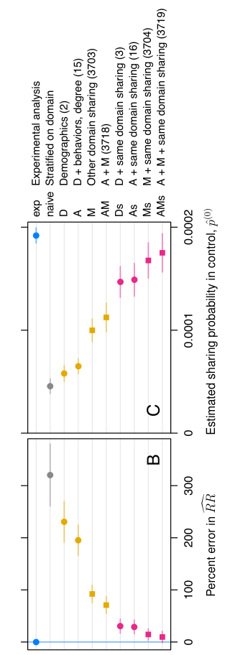
Example: Regularized propensity score
What is the effect of the Facebook news feed?
Counterfactual: Would a user have shared a URL had they not exposed to it using the Feed?
Over 3700 co-variates for matching.
Use logistic regression with L2 regularization.
Eckles and Bakshy. Bias and high-dimensional adjustment in
observational studies of peer effects.

Slide 5
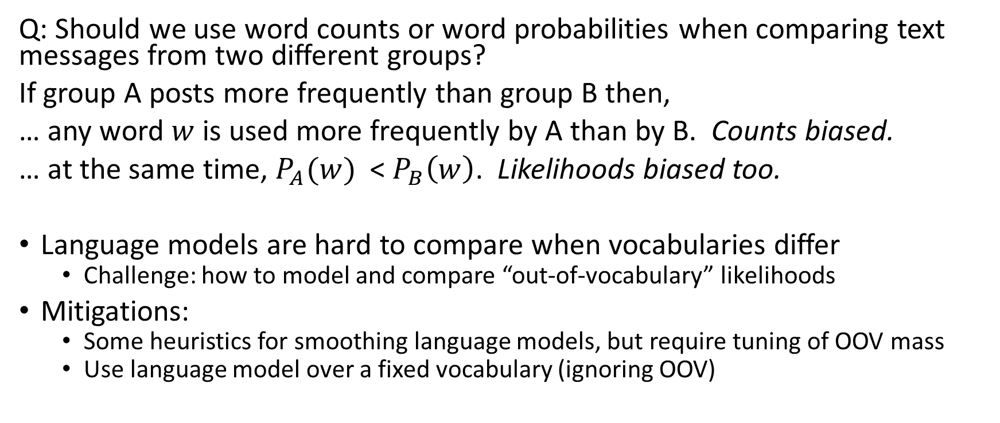
Paradox of measuring text with changing post frequency
Q: Should we use word counts or word probabilities when comparing text messages from two different groups?
If group A posts more frequently than group B then,
… any word $w$ is used more frequently by A than by B. Counts biased.
… at the same time, $P_{A}(w)$ < $P_{B}\left(w\right)$. Likelihoods biased too.
Language models are hard to compare when vocabularies differ
Challenge: how to model and compare “out-of-vocabulary” likelihoods
Mitigations:
Some heuristics for smoothing language models, but require tuning of OOV mass
Use language model over a fixed vocabulary (ignoring OOV)

Slide 6
PART III. Special considerations with large-scale and network data
High-dimensional data
Network Effects
Data about People
Notes:
In this part, we focus on basic methods for causal inference, with integrated learning about assumptions and validation tests. Methods will be demonstrated using a Jupyter python notebook and examples of causal problems in online social data.

Slide 7
Interference due to network effects
Network effects complicate causal inference.
If a person is exposed to some information, she might share with her friends.
Due to the exposure, her friends’ outcome may also change.
Breaks the SUTVA assumption: an individual’s outcome should not depend on another’s treatment status.
Consider partitioned sub-networks as a unit of analysis.
Design alternative randomization assignment or estimator.
Notes:
Mention the new Zealand example.

Slide 8
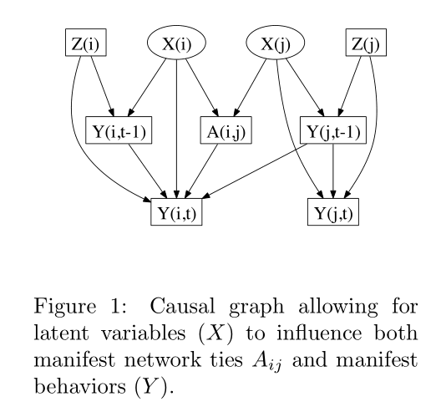
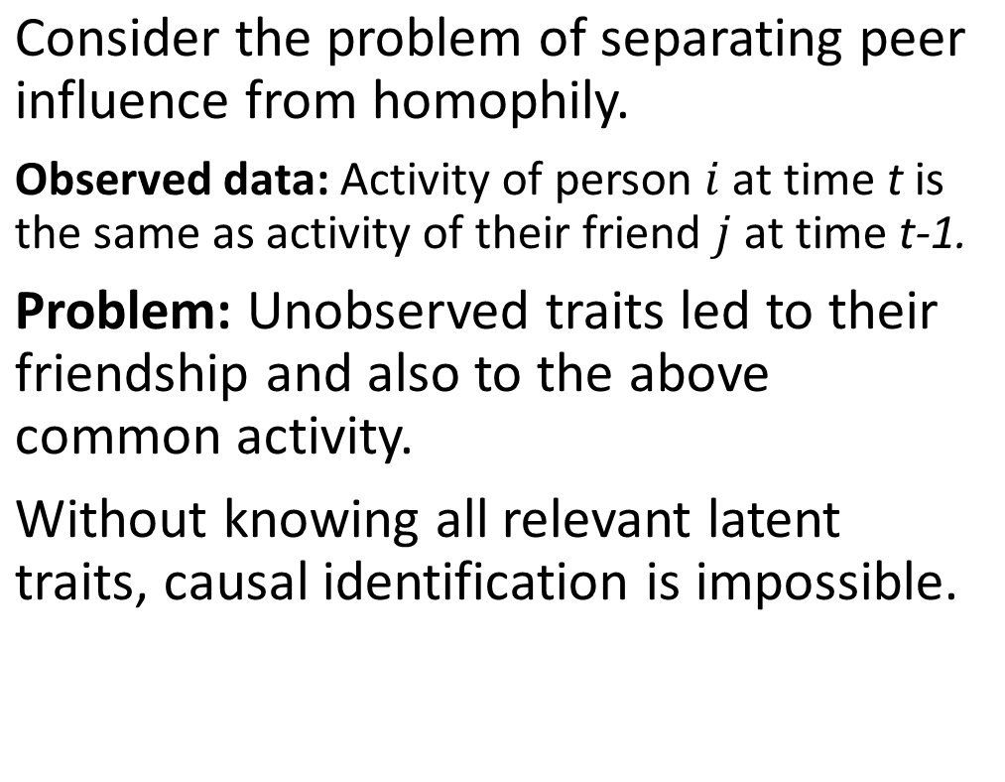
Example: Identifying peer effects with observational studies is impossible(!)
Consider the problem of separating peer influence from homophily.
Observed data: Activity of person $i$ at time t is the same as activity of their friend $j$ at time t-1.
Problem: Unobserved traits led to their friendship and also to the above common activity.
Without knowing all relevant latent traits, causal identification is impossible.
Shalizi and Thomas. Homophily and Contagion Are Generically Confounded in Observational Social Network Studies.

Slide 9
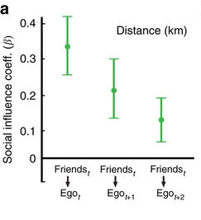
Example: Use aggregated sub-networks
Question: Do peers influence us to exercise?
Instead of individuals, consider all users in a city as a unit.
Use rainfall to construct a natural experiment on running and do checks to validate IV assumptions to the extent possible.
Aral and Nicolaides. Exercise contagion in a global social network. Nature communications 2017.

Slide 10
PART III. Special considerations with large-scale and network data
High-dimensional data
Network Effects
Data about People
Notes:
In this part, we focus on basic methods for causal inference, with integrated learning about assumptions and validation tests. Methods will be demonstrated using a Jupyter python notebook and examples of causal problems in online social data.

Slide 11
Everything depends on context
Estimated effect is often context-dependent
May not generalize to other users
May not generalize to other platforms
May not generalize to other cultures
The WEIRD problem of social science studies.
Corroborate findings with multiple platforms or user samples.
Be explicit about plausible (non)-generalizability of causal effect.

Slide 12
Common confounders that lead to selection bias
Structured
Demographics (e.g., gender, age, income)
Patterns of usage(e.g., number of logins, type of activity)
Unstructured
Activity (e.g., post content, images)
Preferences (e.g., items interacted with)
Notes:
A lot is explained by demographics.
Past activity data is Selection bias
Activity bias
Interaction with the system’s algorithms and recommendations
School ability bias—often what you need is not measured.

Slide 13
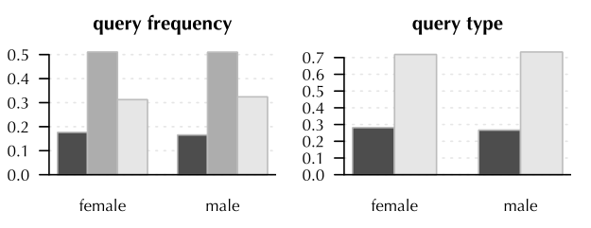
Demographic Bias
Online activity varies by demographics such as Age and Gender.
Search engines, recommendation feeds are measured on metrics such as “Time spent on referred page”.
Without controlling for Age, metric is not trustworthy.
Age
Search Result
Time spent on page
Mehrotra et al. Auditing Search Engines for Differential Satisfaction Across Demographics, WWW 2017.

Slide 14
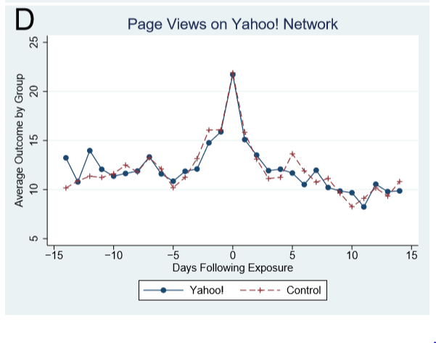
Usage Bias
More activity can simply mean that people are online at the time, not due to any specific treatment.
People browse more ad-related products when they are shown an ad. But they also browse more of everything!
Online activity
Ad exposure
Ad-related page view
Lewis, Rao and Reily. Here, There, and Everywhere: Correlated Online Behaviors Can Lead to Overestimates of the Effects of Advertising. WWW 2011.

Slide 15
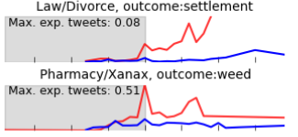
Activity Bias
Treated and untreated people may differ in many aspects.
People with demonstrably different activity content should not be compared.
Match people with similar activity content that is relevant to chances of being treated.
User Activity
Event
Outcome
Olteanu, Varol and Kiciman. Distilling the Outcomes of Personal Experiences:
A Propensity-scored Analysis of Social Media. CSCW 2017.

Slide 16
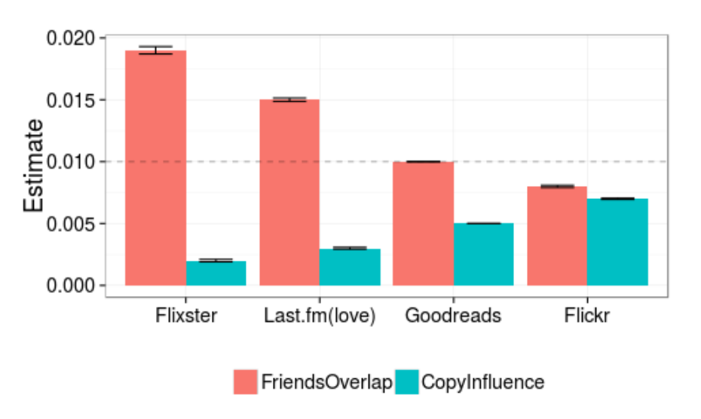
Preference Bias
Any similarity in activity may be due to inherent preferences, not any specific treatment.
Social influence from friends’ feeds is most likely over-estimated because similarity in actions can be homophily.
Vast majority of people’s behavior can be predicted by their past actions.
Homophily
Friends’ feed
Similarity with Friends
Sharma and Cosley. Distinguishing between Personal Preferences and Social
Influence in Online Activity Feeds. CSCW 2015.

Slide 17
PART I. Introduction to Counterfactual Reasoning PART II. Methods for Causal Inference PART III. Large-scale and Network Data PART IV. Broader Landscape
Notes:
In this part, we focus on basic methods for causal inference, with integrated learning about assumptions and validation tests. Methods will be demonstrated using a Jupyter python notebook and examples of causal problems in online social data.

